Slide 1
INFORMATION SYSTEMS SECURITY, CONTROL AND AUDIT
Information Systems Security
AUDITING, TESTING AND MONITORING
Week 6

Slide 2
Security Auditing and Analysis
Defining an Audit Plan
Auditing Benchmarks
Audit Data Collection Methods
Post Audit Activities
Security Monitoring
Capturing Log information
Verifying Security Controls
Monitoring and Testing Security Systems

Slide 3
Auditing
Auditing is a systematic process of objectively obtaining and evaluating evidence regarding assertions about economic actions and events to ascertain the degree of correspondence between those assertions and establishing criteria and communicating the results to interested users.

Slide 4
Audit Planning
Survey the Site
Review Documentation
Review Risk Analysis Output
Review Host Logs
Review Incident Logs
Review Results of Penetration Tests

Slide 5
Audits
Phases:
  1. Planning
  2. Obtaining evidence
    Tests of Controls
    Substantive Testing
      CAATTs
      Analytical procedures
  3. Ascertaining reliability
    MATERIALITY
  4. Communicating results
    Audit opinion

Slide 6
Risk Based Internal Auditing
RBIA is an approach that can help to meet the Internal Audit Mandate. The approach is also consistent with the Turnbull guidance Internal Control: Guidance for Directors on the Combined Code, which requires directors to adopt “a risk-based approach to establishing a sound system of internal control and reviewing its effectiveness”, and to embed risk management and internal control into the culture of the organisation.

Slide 7
Risk Based Internal Auditing
A number of principles applying to best practice in risk management were adopted as mentioned below:
Risk recognition. Risks are recognized as being owned at the right level and links risk mitigation with the achievement of a process objective and required deliverables. For each risk there must be a named owner. That person will have direct responsibility for managing those risks and are accountable even for progressing action plans to bring the exposure back within tolerance as guided by the management risk appetite.

Slide 8
Risk Based Internal Auditing
Risk escalation. There may be a number of reasons why a process owner is not able to manage a risk, for example, external factors beyond their control and insufficient time or resources. The process owner must, then, clearly and openly escalate the report for informed decisions at the next level upwards.
Risk appetite. Management can decide that a risk, in terms of impact and likelihood, is within the acceptable tolerance, or risk appetite.

Slide 9
Risk Based Internal Auditing
Impact of an occurrence means how a breach of an internal control in an area affects the achievement of business objectives and the success of the business in the short and long-term.
Likelihood is simply whether a consequential breach has ever occurred, can occur and the chances of occurrence thereof.

Slide 10
Risk Based Internal Auditing
Risks are classified along a continuum from very low to very high. A rating system of discrete variables from “0” to “5” is used.
On this scale 1=Very low likelihood/or impact while 2=Low, 3=Medium, 4=High and 5=Very High, respectively.
A matrix indicating the risk rating based on the product of Likelihood and Impact is shown below. The bold line indicates the risk appetite level.
Low (Acceptable) - Immediate action required to manage the risk.
Medium (Issue) - Action required to manage the risk.
High (Unacceptable) - No action required.
(see Risk Criteria Word Document)

Slide 11
What is an IT Audit?
… most accounting transactions to be in electronic form without any paper documentation because electronic storage is more efficient. … These technologies greatly change the nature of audits, which have so long relied on paper documents.

Slide 12
Audit Benchmarks
ISO 27002
NIST SP 800
ITIL
COBIT
COSO

Slide 13
Brief History - COSO
Committee on Sponsoring Organizations - 1992
  AICPA, AAA, FEI, IMA, IIA
  Developed a management perspective model for internal controls over a number of years
  Is widely adopted

Slide 14
COSO Internal Control Framework
COSO (Treadway Commission)
  The control environment
  Risk assessment
  Information & communication
  Monitoring
  Control activities
Hall, 3e

Slide 15
Monitoring
By separate procedures (e.g., tests of controls)
By ongoing activities (Embedded Audit Modules – EAMs and Continuous Online Auditing - COA)

Slide 16
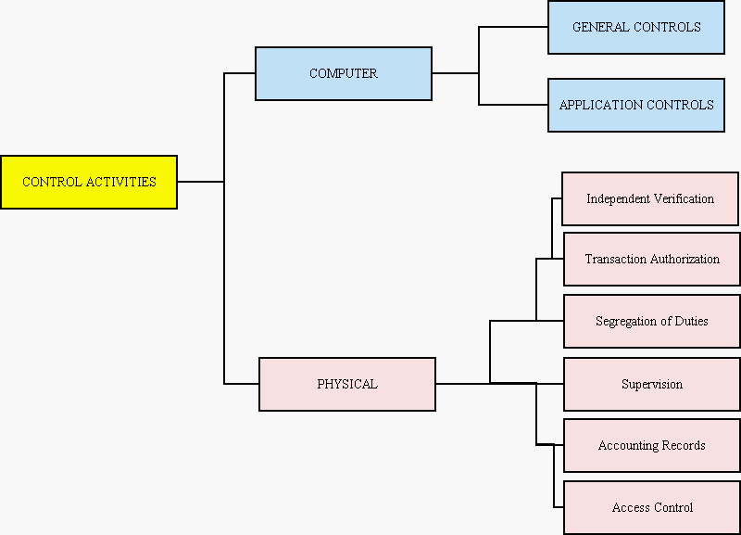
COSO
(Control Activities)
© 2011 Cengage Learning. All Rights Reserved. May not be scanned, copied or duplicated, or posted to a publicly accessible wbsite, in whole or in part.

Slide 17
Audit Data Collection Methods
Questionnaires
Interviews
Observation
Checklists
Reviewing Documentation
Reviewing Configurations
Reviewing Policy
Performing Security Testing

Slide 18
Tools for Security Monitoring
Baselines
Alarms
Closed Circuit TV
Systems that spot Irregular behavior e.g. IDSS
Computer System Monitoring
Application Logging
System Logging
Host-Based Activity
Network and Network Devices

Slide 19
Logging Anomalies
False Positives – Type 1 Errors
False Negatives – Type 2 Errors

Slide 20
Log Management
Log files are good sources of evidence
The Security Information and Event Management (SIEM) systems helps organizations manage the explosive growth of their files.
IBM Qradar is a good example.
IBM® Security QRadar® SIEM consolidates log source event data from thousands of devices endpoints and applications distributed throughout a network. It performs immediate normalization and correlation activities on raw data to distinguish real threats from false positives.

Slide 21
Log Management
As an option, this software incorporates IBM Security X-Force® Threat Intelligence which supplies a list of potentially malicious IP addresses including malware hosts, spam sources and other threats. IBM Security QRadar SIEM can also correlate system vulnerabilities with event and network data, helping to prioritize security incidents.
Provides near real-time visibility for threat detection and prioritization, delivering surveillance throughout the entire IT infrastructure.
Reduces and prioritizes alerts to focus investigations on an actionable list of suspected incidents.
Enables more effective threat management while producing detailed data access and user activity reports.
Delivers security intelligence in cloud environments.
Produces detailed data access and user activity reports to help manage compliance.

Slide 22
Security Controls
IDS
  Pattern (signature) based IDS
  Anomaly Based IDSs
    Statistical-based methods
    Traffic-based methods
    Protocol Patterns
    HIDS – Watches over sensitive processes inside the computer

Slide 23
Security Controls – NIDS/HIDS
Network Intrusion Detection System
The NIDS helps protect the system from malicious network traffic. The HIDS on the other sees the types of activity being attempted on the host itself.
Host intrusion detection systems (HIDS) and network intrusion detection systems (NIDS) are methods of security management for computers and networks. In HIDS, anti-threat applications such as firewalls, antivirus software and spyware-detection programs are installed on every network computer that has two-way access to the outside environment such as the Internet. In NIDS, anti-threat software is installed only at specific points such as servers that interface between the outside environment and the network segment to be protected.

Slide 24
Security Controls – NIDS/HIDS
In NIDS, anti-threat software is installed only at specific points such as servers that interface between the outside environment and the network segment to be protected.
All methods of intrusion detection (ID) involve the gathering and analysis of information from various areas within a computer or network to identify possible threats posed by hackers and crackers inside or outside the organization. Host-based and network-based ID systems have their respective advantages and limitations. The most effective protection for a proprietary network is provided by a combination of both technologies.

Slide 25
Monitoring and Testing Security Systems
It is impossible to achieve 100% Security. To be able to maintain a high security posture it is important to:
Conduct Monitoring
Testing
  Reconnaissance
  Network Mapping
  Vulnerability Testing
  Penetration Testing
  Mitigation Activities

Slide 26
Network Mapping Method
Is an extended type of reconnaissance. Network mapping discovers details about a network, including its hosts and host addresses as well as available services.

Slide 27
Testing Methods
Black Box Testing
White-box Testing
Gray Box Testing
When testing you should consider the below:
Choose the right tool
Tools are not fool-proof
Protect your systems
Tests should be as “real as possible

Slide 28
Research on various SIEMS in the market and determine their collection methods.

Slide 29
Revision of the OSI Model + Report on Group Engagement Plan Progress

Slide 30
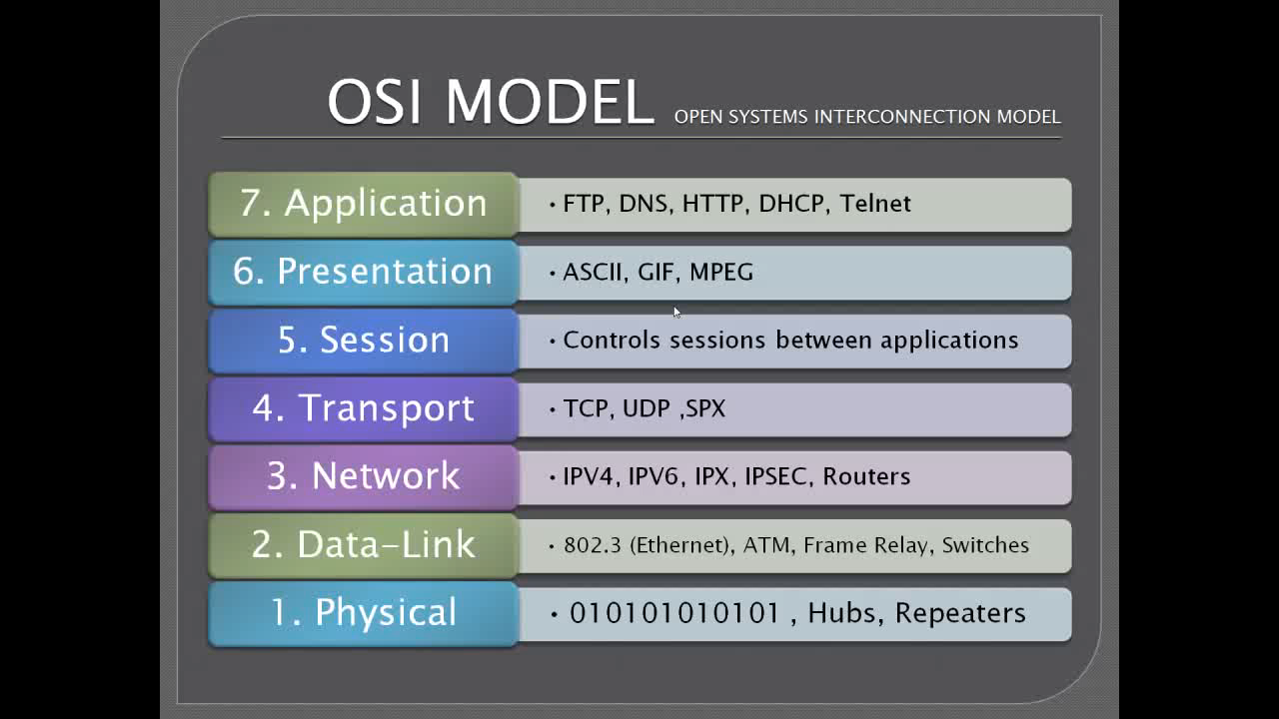
OSI MODEL

Slide 31
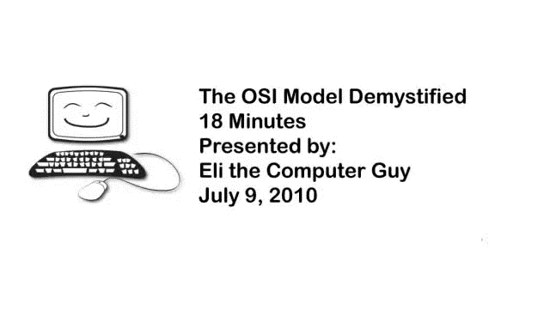
OSI MODEL

